Slide 1
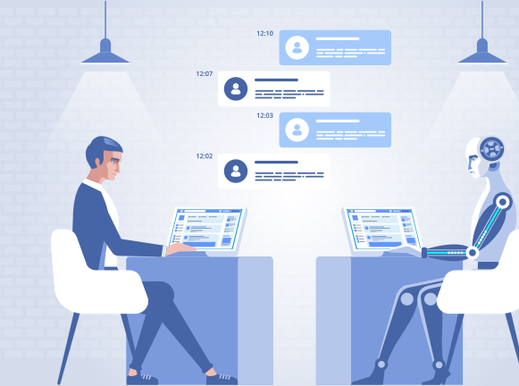
AI Enabled Recommendation Chatbot
Team Members:
Amit Barik
Chirag Sharma
Himanshu Kesarvani
Seshadri Deb Roy

Slide 2
Introduction:
Innodatatics Inc. (Sponsor):
A consulting and product development company which aims in unearthing insights and solutions for their customers. The company solves critical business solutions for their customers using Machine learning and AI Deep Learning cutting edge technologies.
Client expectation:
This project is specific to develop a AI enabled recommendation for a chatbot. The chatbot should be able to recommend useful module links based on student queries.
Problem Statement:
The AI Chatbot needs have the capability based on NLP and ML so that it is able to respond to the student queries. The students is assuming to be registered. The student enlisted in various modules needs to have recommendation for the other courses he may take. An AI enabled recommendation chatbot will serve the purpose.

Slide 3
USER JOURNEY:

Slide 4
Project Journey:
Initial Project Description
Project Understanding
Project Kick-Off
Requirement Changes
Agile Framework
Communication with Sponsors and Faculty Mentor
Technical Challenges

Slide 5
APPLICATION LAYERS
Front-end Application – Web app with chatbot UI which receive questions from user in text and speech format.
REST API Services – Receive HTTP GET request containing user query and forward them to ML based model
ML Model – Model will receive the string query and process to extract the key words/labels. This model will also be responsible to extract key words from the video files too.
Database – Store key words/labels in the database with module info
Recommendation – Query database and fetch resources matching with the key words extracted from string query. If match found in user subscribed course it will return module link in the recommendation. If match found in module not subscribed by user then it will return link of course landing page. If nothing matches then it will return default message.

Slide 6
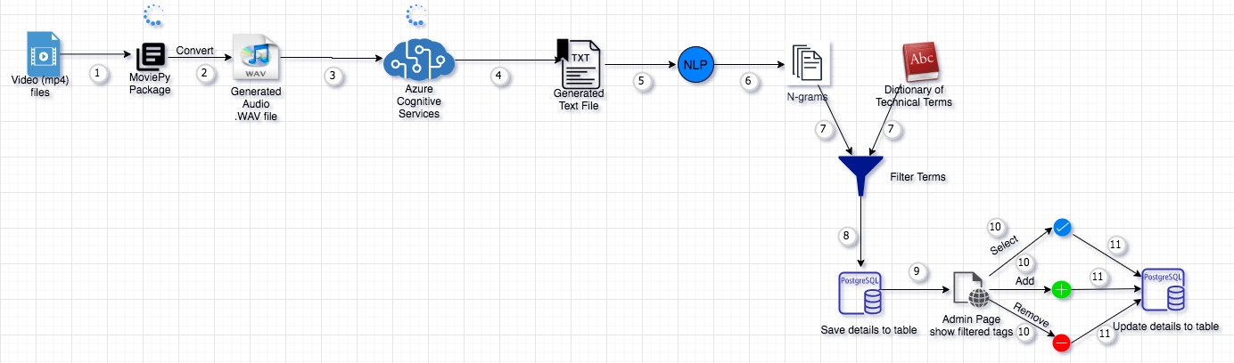
ARCHITECTURE DIAGRAM VIDEO PROCESSING

Slide 7
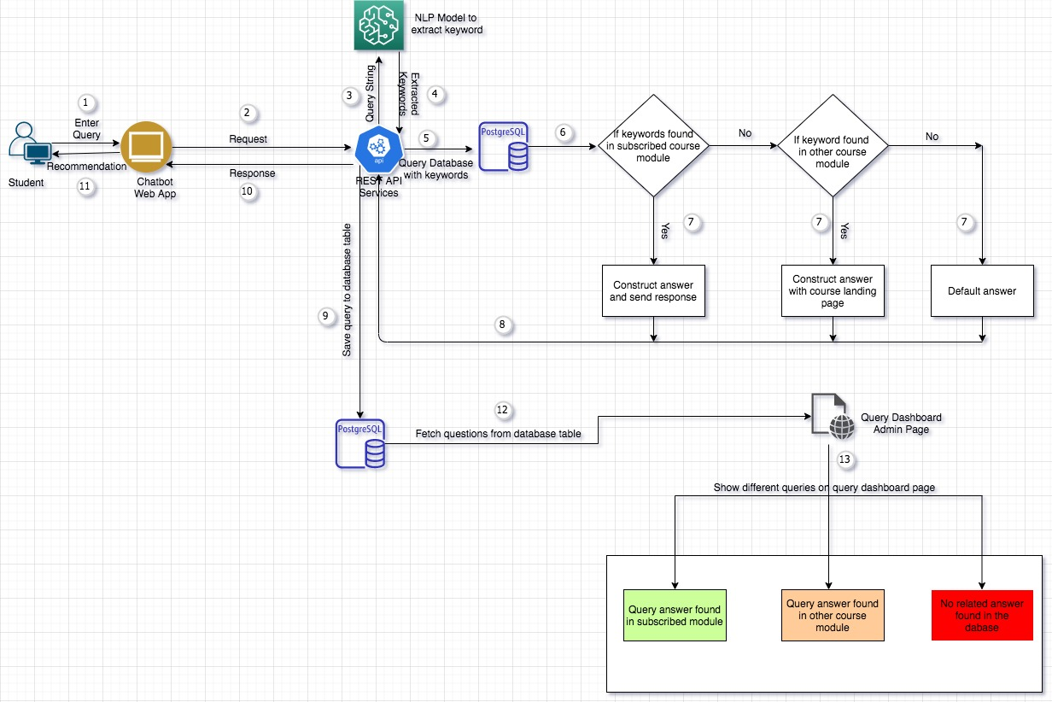
ARCHITECTURE DIAGRAM USER PERSPECTIVE

Slide 8
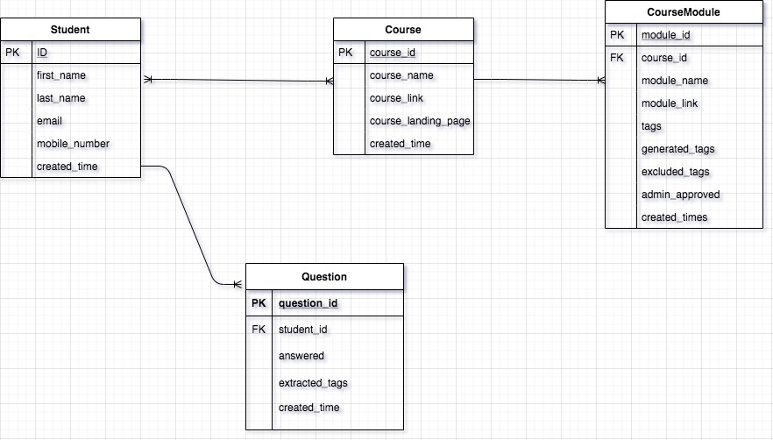
Database Architecture(Entity Relationship Diagram)

Slide 9
Comparative study between different Speech to Text Methods:ween different Speech to Text methods
Method | Description | Converted text
Deep Speech(v0.6) | DeepSpeech is an open source Speech-To-Text engine, using a model trained by machine learning techniques based on Baidu's Deep Speech research paper | for a rod the are very tame moreover a yeoman a eneas fish also tea a la la romana memorat o the artesian corollaries the Hermione as the latter was a fine early the one old man ever or tomfooleries all onotawah murmured betrothed must readmore
Pocket Sphinx | Pocketsphinx is a part of the CMU Sphinx Open Source Toolkit For Speech Recognition. | mm her art or her or him on blue were or new were are you are working here are are you to your need career or who need our law hill and longer a wall.
Azure Speech to Text(Cognitive Services) | Speech-to-text from the Speech service, also known as speech recognition, enables real-time transcription of audio streams into text. | So classic. What are we doing clustering? Grouping. Homogeneous data points exactly. We group homogeneous data to create a cluster. This is performed generally as part of our eda concepts.
Topic-Non Hierarchial/K-Means Clustering

Slide 10
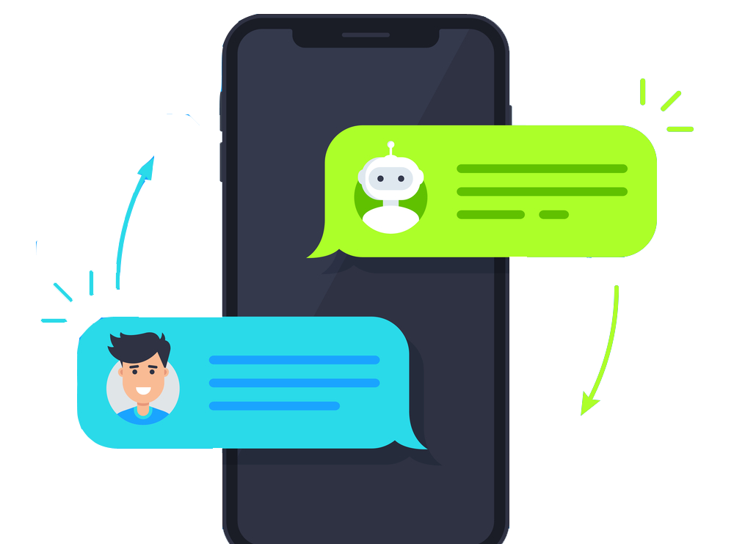
FINISHED ITEMS:
Extraction of Audio From Video
Speech to text Conversion Using
Azure Cognitive Services
Google Cloud API
Tag Generation
Admin Page For Tag Selection
Admin Page Query Dashboard
Chatbot UI
Middleware API
Database Design
Database Schema
Table Generation

Slide 11
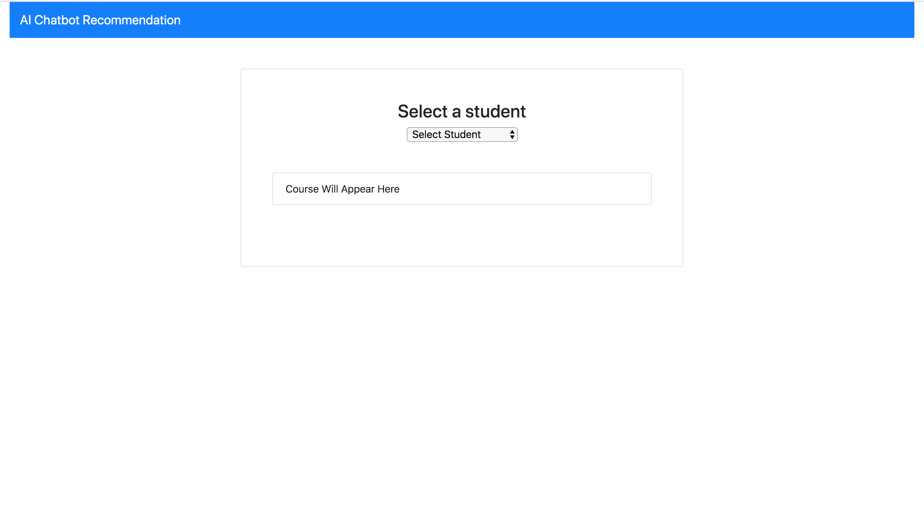
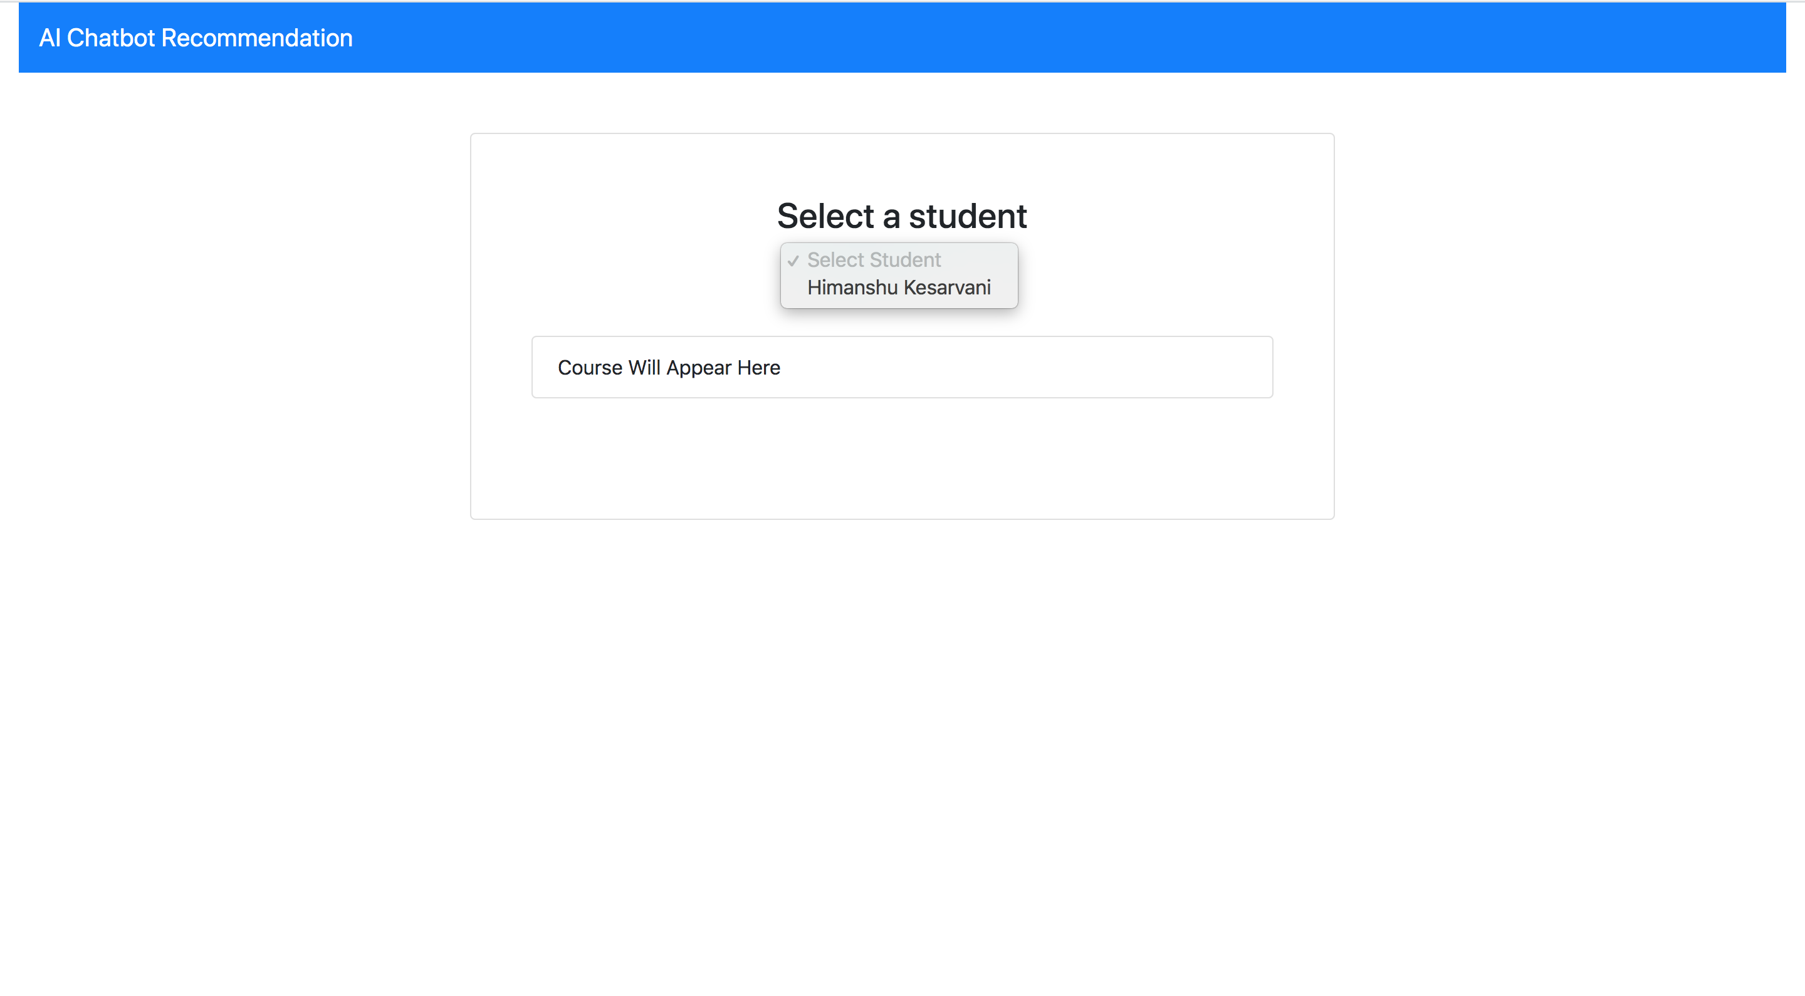
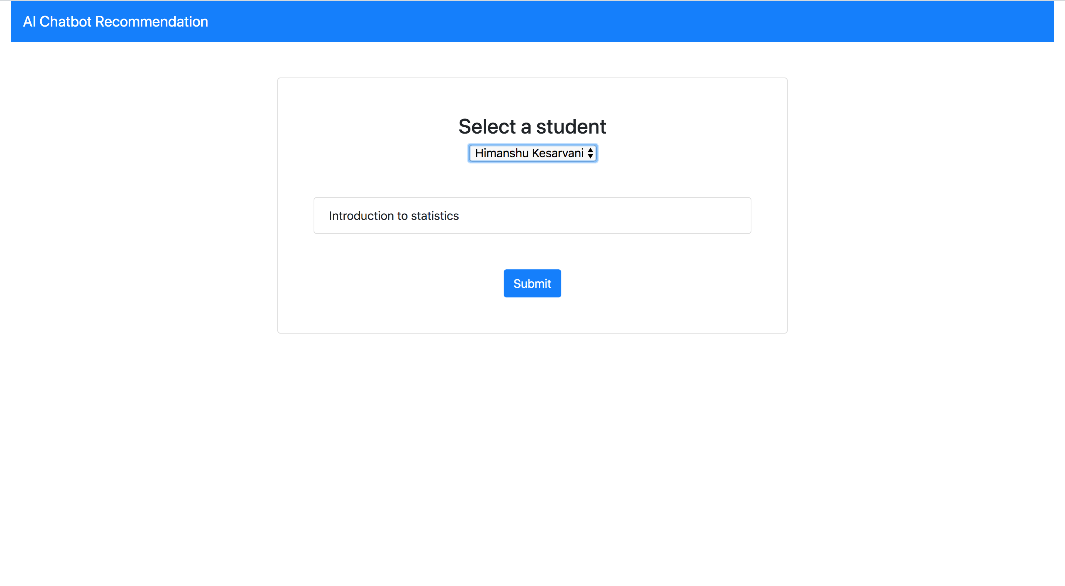
ILLUSTRATIONS OF FINISHED ITEMS:
Home Screen
Student Selection Page
Submit Selected Student

Slide 12
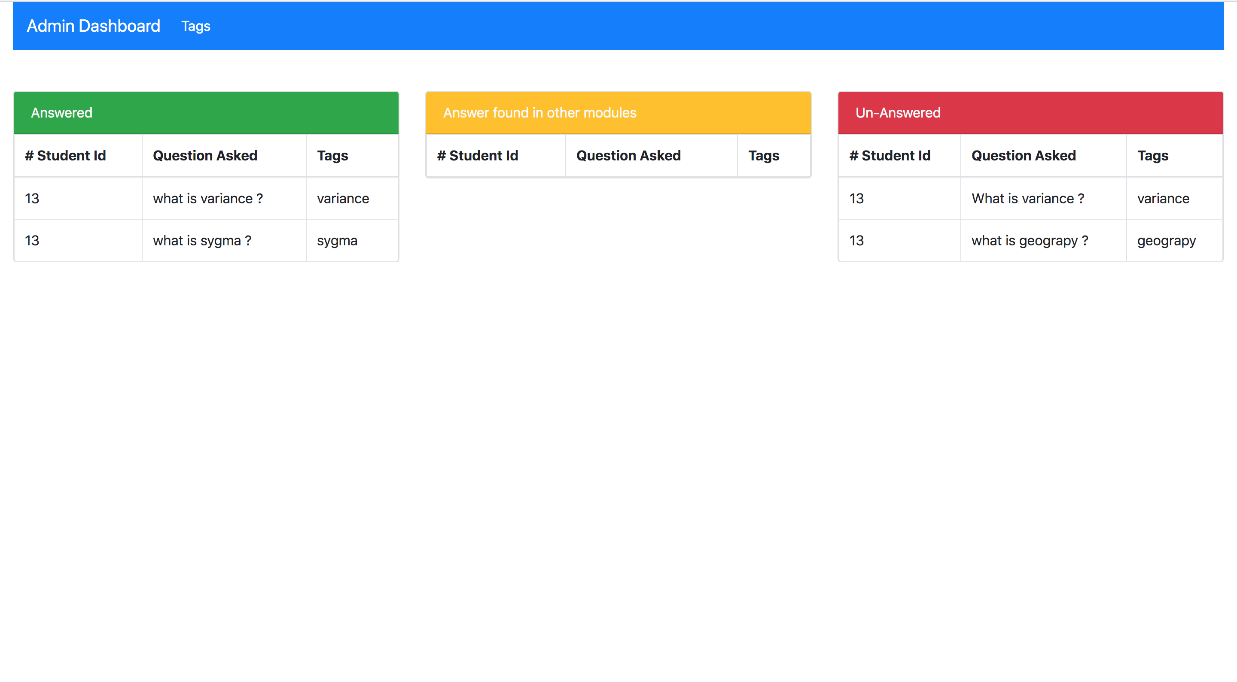
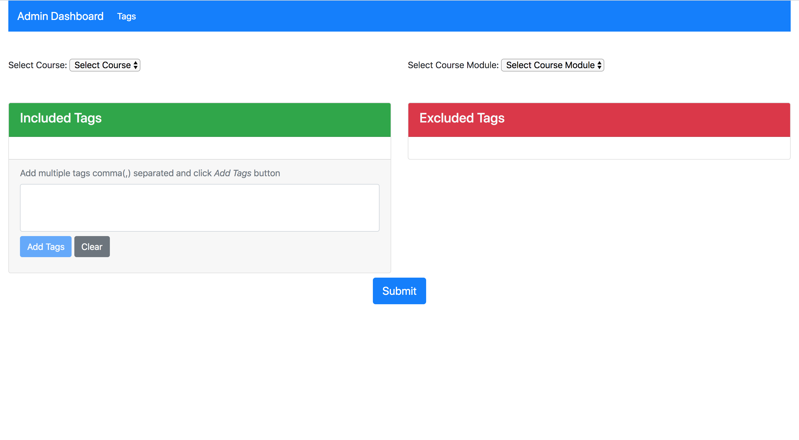
ILLUSTRATIONS:
QUERY ADMIN:
TAG ADMIN:

Slide 13
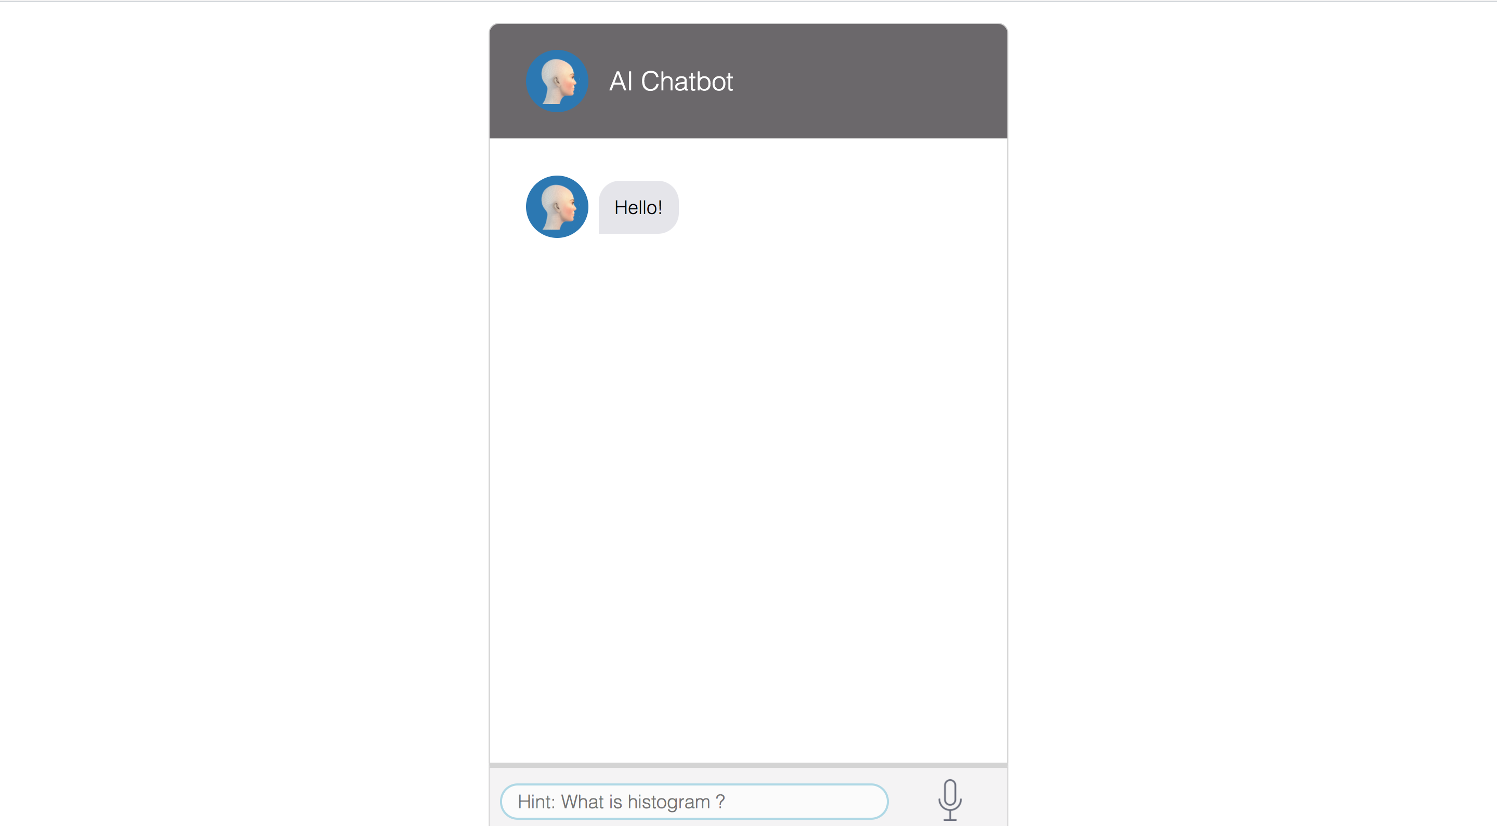
ILLUSTRATIONS:

Slide 14
DEMO

Slide 15
Q&A

